Slide 1
Text to speech and voice cloning
Presentation By:-
Dhairya Kumar Sharma (500067932)
Muskan Sawa (500067886)
Akash Raj (500068004)
Under The Guidance Of :-
Dr. Ravi Tomar [Assistant Professor(SG)]

Slide 2
Introduction
Allowing people to converse with machines is a long-standing dream of human-computer interaction. The ability of computers to understand natural speech has been revolutionised in the last few years by the application of deep neural networks (e.g., Google Voice Search). However, generating speech with computers — a process usually referred to as speech synthesis or text-to-speech (TTS) — is still largely based on so-called concatenative TTS, where a very large database of short speech fragments are recorded from a single speaker and then recombined to form complete utterances. This makes it difficult to modify the voice (for example switching to a different speaker, or altering the emphasis or emotion of their speech) without recording a whole new database.
This has led to a great demand for parametric TTS, where all the information required to generate the data is stored in the parameters of the model, and the contents and characteristics of the speech can be controlled via the inputs to the model. So far, however, parametric TTS has tended to sound less natural than concatenative. Existing parametric models typically generate audio signals by passing their outputs through signal processing algorithms known as vocoders.

Slide 3
OBJECTIVE
Main objectives:
Text to speech using different mel models and vocoders
Web Application connected with a database to display and save outputs properly
Real time voice cloning

Slide 4
Tacotron 2
Tacotron is an AI-powered speech synthesis system that can convert text to speech. Tacotron 2’s neural network architecture synthesises speech directly from text. It functions based on the combination of convolutional neural network (CNN) and recurrent neural network (RNN).

Slide 5
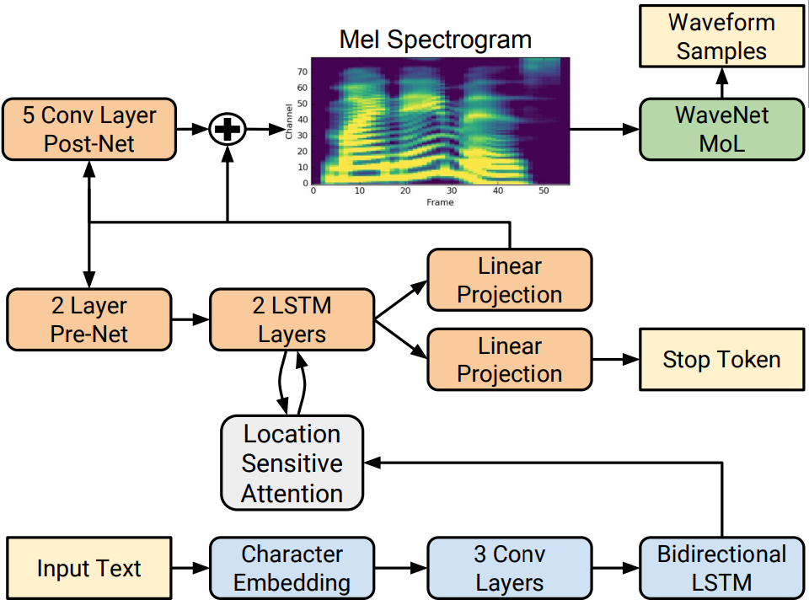

Slide 6
fastspeech
Fastspeech is a novel feed-forward network based on Transformer to generate mel-spectrogram in parallel for TTS. Specifically, we extract attention alignments from an encoder-decoder based teacher model for phoneme duration prediction, which is used by a length regulator to expand the source phoneme sequence to match the length of the target mel-spectrogram sequence for parallel mel-spectrogram generation.
Fastspeech is fast ,robust and controllable.

Slide 7
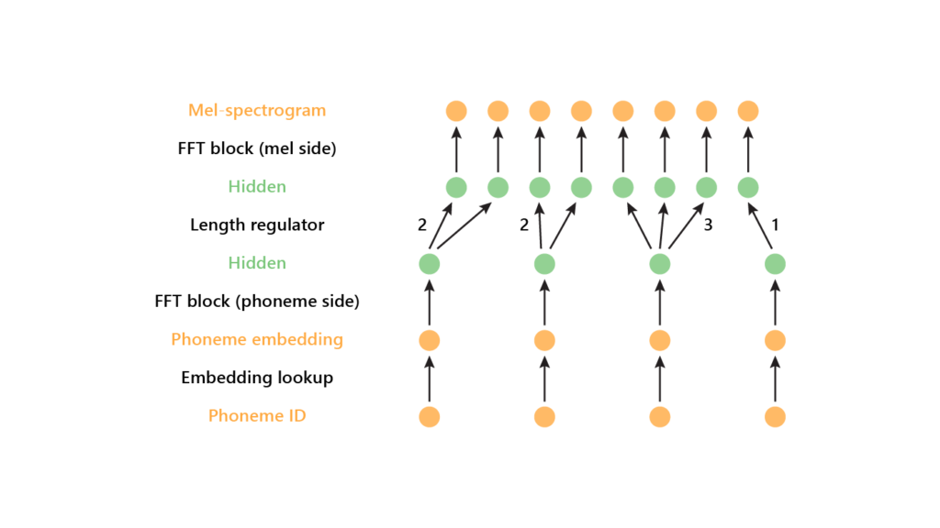

Slide 8
fastspeech2
FastSpeech 2 is the first attempt to directly generate waveform from phoneme sequence fully in parallel, instead of linguistic features or mel-spectrograms. The output linear layer in the decoder converts the hidden states into 80-dimensional mel-spectrograms and our model is optimized with mean absolute error (MAE).

Slide 9
GAN - Generative adversarial networks
A generative adversarial network is a class of machine learning frameworks.
Generative adversarial networks (GANs) are algorithmic architectures that use two neural networks, pitting one against the other (thus the “adversarial”) in order to generate new, synthetic instances of data that can pass for real data. They are used widely in image generation, video generation and voice generation
Recently, GAN vocoders have seen rapid progress in speech synthesis, starting to outperform autoregressive models in perceptual quality with much higher generation speed. However, autoregressive vocoders are still the common choice for neural generation of speech signals coded at very low bit rates.

Slide 10
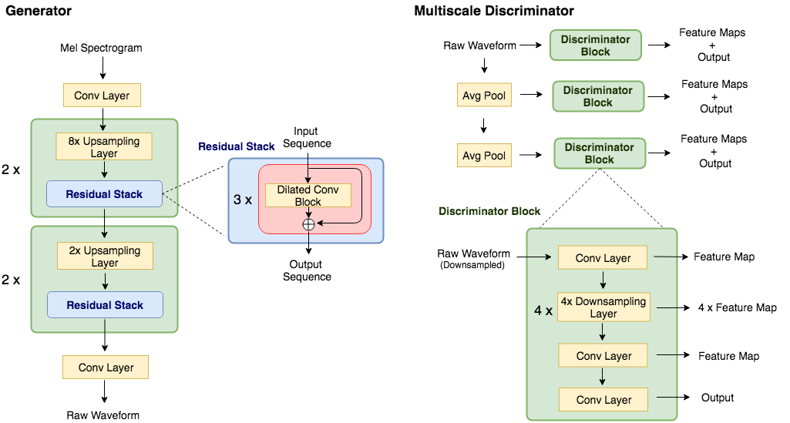

Slide 11
MULTIBAND MELGAN
Multi-band MelGAN, a much faster waveform generation model targeting to high-quality text-to-speech.
MelGAN is extended with multi-band processing: the generator takes mel-spectrograms as input and produces sub-band signals which are subsequently summed back to full-band signals as discriminator input.
It increases the receptive field of the generator, which is proven to be beneficial to speech generation.

Slide 12
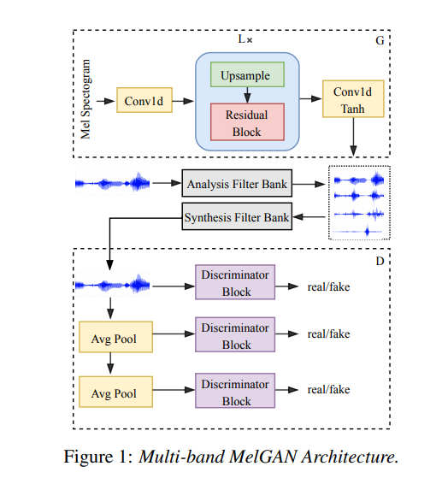

Slide 13
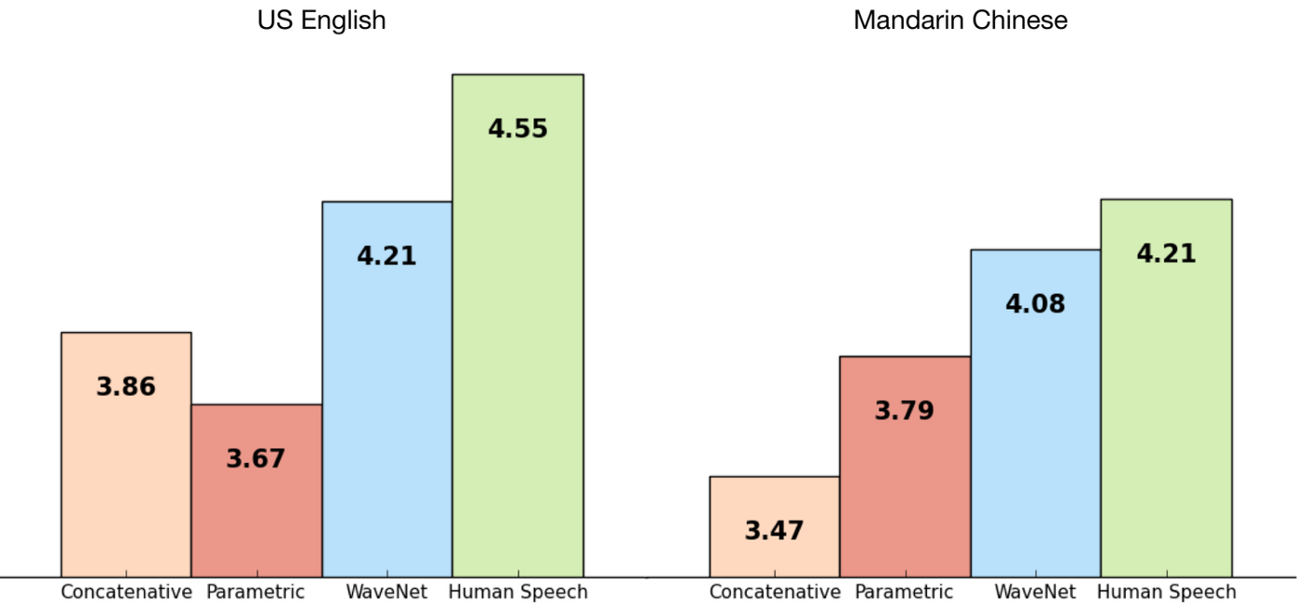
How do we know which system is better?
In order to draw a comparison between WaveNet and existing speech synthesizing approaches, subjective 5-scale Mean Opinion Score (MOS) tests were conducted. In the MOS tests, subjects (humans) were presented with speech samples generated from either of the speech synthesizing systems and were asked to rate the naturalness of the speech sample in a five-point scale score (1: Bad, 2: Poor, 3: Fair, 4: Good, 5: Excellent).

Slide 14
How is fastspeech different from tacatron?
Neural network based end-to-end text to speech (TTS) has significantly improved the quality of synthesized speech. Prominent methods (e.g., Tacotron 2) usually first generate mel-spectrogram from text, and then synthesize speech from the mel-spectrogram using vocoder such as WaveNet. Compared with traditional concatenative and statistical parametric approaches, neural network based end-to-end models suffer from slow inference speed, and the synthesized speech is usually not robust (i.e., some words are skipped or repeated) and lack of controllability (voice speed or prosody control). Fastspeech eliminates the problem of word skipping and repeating in particularly hard cases, and can adjust voice speed smoothly. Most importantly, compared with autoregressive Transformer TTS, our model speeds up mel-spectrogram generation by 270x and the end-to-end speech synthesis by 38x.

Slide 15
Fastspeech vs Fastspeech2
FastSpeech has several disadvantages:
1) the teacher-student distillation pipeline is complicated and time-consuming
2) the duration extracted from the teacher model is not accurate enough, and the target mel-spectrograms distilled from teacher model suffer from information loss due to data simplification, both of which limit the voice quality.
1) FastSpeech 2 achieves a 3x training speed-up over FastSpeech, and FastSpeech 2s enjoys even faster inference speed
2) FastSpeech 2 and 2s outperform FastSpeech in voice quality, and FastSpeech 2 can even surpass autoregressive models.

Slide 16
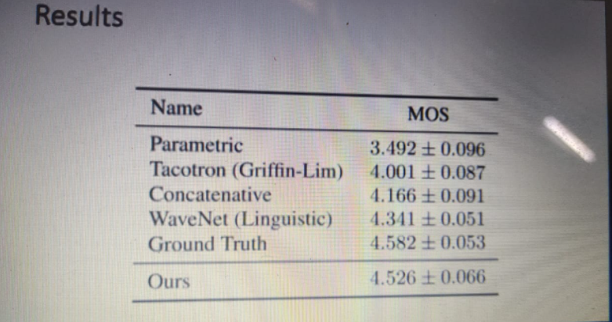

Slide 17
How is Multi-Band MelGAN better?
First, it has greater receptive field of the generator, which is proven to be beneficial to speech generation. Second, there is a feature for matching loss with the multi-resolution STFT loss to better measure the difference between fake and real speech. Together with pre-training, this improvement leads to both better quality and better training stability. More importantly, In MelGAN with multiband processing, the generator takes mel-spectrograms as input and produces sub-band signals which are subsequently summed back to full-band signals as discriminator input.

Slide 18
Literature Review:
Over time, different techniques have dominated the field. Concatenative & Statistical parametric speech synthesis. However, the audio produced by these systems often sounds muffled and unnatural compared to human speech. Here comes the, Tacotron 2 which is introduced as a completely neural TTS framework that consolidates a sequence-to-sequence recurrent network with thoughtfulness regarding predicts Mel spectrograms with an adjusted WaveNet vocoder. The subsequent framework incorporates discourse with Tacotron-level prosody and WaveNet-level sound quality. This framework is been prepared straightforwardly from information without depending on complex component designing, and accomplishes best in class sound quality near that of regular human discourse [1]. Tacotron produces mel-spectrogram which is passed through a wavenet vocoder MelGAN, a non-autoregressive feed-forward convolutional architecture to perform audio waveform generation in a GAN setup. We come to know that we can successfully train GANs for raw audio generation without additional distillation or perceptual loss functions while still yielding a high quality text-to-speech synthesis mode [2]. The introduction to use the multi-band MelGAN, a much faster waveform generation model targeting to high-quality text-to-speech as compared to melGAN has been clarified here. The improvement associated with mb-MelGAN is because of two reasons-1. increase the receptive field of the generator,

Slide 19
2. Substituting the feature matching loss with the multi-resolution STFT loss to better measure the difference between fake and real speech [3]. Also, keeping in mind that every technology comes with its own advantage as well as disadvantage and in the case of tacotron we have seen some of its limitations i.e. suffering from slow inference speed, and the synthesized speech is usually not robust (i.e., some words are skipped or repeated) and lack of controllability (voice speed or prosody control).So here comes the introduction of Fastspeech which is a novel feed-forward network based on Transformer to generate mel-spectrogram in parallel for TTS, in this it extricate consideration arrangements from an encoder-decoder based instructor model for phoneme span expectation, which is utilized by a length regulator to extend the source phoneme succession to coordinate with the length of the objective mel-spectrogram grouping for parallel mel-spectrogram age. Basically, Fastspeech speeds up mel-spectrogram generation by 270x and the end-to-end speech synthesis by 38x. [4]. Another main thing about Fastspeech is that it also suffers from some limitations such as 1) the teacher-student refining pipeline is convoluted and tedious, 2) the length extricated from the teacher model isn't sufficiently precise, and the objective mel-spectrograms refined from teacher model experience the ill effects of data misfortune because of information disentanglement, the two of which limit the voice quality. So there is need to tackle all this problem and here comes Fastspeech 2 which addresses the issues in FastSpeech and better solves the one-to-many mapping problem in TTS by directly train the model with ground-reality of data instead of teacher’s simplified output and also giving more variation information of speech like pitch, energy and more accurate duration of words. It is shown that FastSpeech 2 achieves a 3x training speed-up over FastSpeech. [5]
So far, no research has discussed to compare each of models (Tacotron 2, Fastspeech and Fastspeech 2) combining with each of the type of vocoders (melGAN, melGAN-stft and mb-melGAN) and show some systemetic comparison between them. Our projects intends to do the same by using a website which shows result based on selected model and type of vocoder and giving input text.

Slide 20
Requirements
Python 3.7+
Cuda 10.1
CuDNN 7.6.5
Tensorflow 2.2/2.3/2.4/2.5/2.6
Tensorflow Addons >= 0.10.0
MySQL Workbench
Pycharm
Html
Css

Slide 21
Libraries imported
from flask import Flask, render_template, redirect, session, url_for, request
from flask_mysqldb import MySQL
import MySQLdb
import tensorflow as tf
import yaml
import numpy as np
import matplotlib.pyplot as plt
import soundfile as sf
import IPython.display as ipd
from tensorflow_tts.inference import TFAutoModel
from tensorflow_tts.inference import AutoConfig
from tensorflow_tts.inference import AutoProcessor
from IPython.display import Audio
from IPython.utils import io
from IPython.display import display
from synthesizer.inference import Synthesizer
from encoder import inference as encoder
from vocoder import inference as vocoder
from pathlib import Path
import librosa

Slide 22
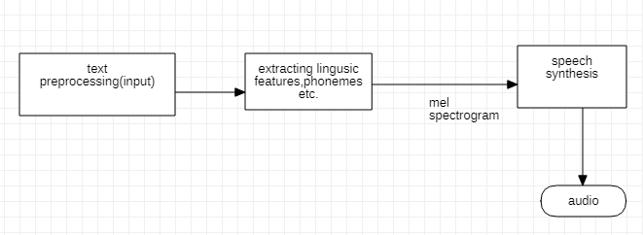
IPC

Slide 23
REFRENCES
[1] J. Shen and R. Pang, "Natural tts synthesis by conditioning wavenet on mel spectrogram predictions," in (ICASSP):(pp. 4779-4783)IEEE, Canada, 2018
[2] K. Kumar, "MelGAN: Generative Adversarial Networks for," in arXiv preprint:1910.06711, Mila, 2019.
[3] G. Yang, "Multi-band MelGAN: Faster Waveform Generation for High-Quality Text-to-Speech," in IEEE: Spoken Language Technology Workshop (SLT), China, 2020.
[4] Y. Ren, "FastSpeech: Fast, Robust and Controllable," in arXiv preprint:1905.09263, China, 2019.
[5] Y. Ren, "FastSpeech 2: Fast and High-Quality End-to-End Text to Speech," in arXiv preprint:2006.04558, China, 2020.

